Slide 1


DAYANANDA SAGAR UNIVERSITY
SCHOOL OF ENGINEERING
Department of Computer Science and Engineering (AIML)
Major Project Phase-I
Phishing Websites Detection Using Machine Learning Algorithms
Under the Supervision
Prof. J RajyeLakshmi
Presented By:
Aayush Gupta (ENG20AM0001)
Abinash Dubey (ENG20AM0003)
Aman Anand (ENG20AM0008)
K Chakaradhar Naidu (ENG21AM3015)

Slide 2
Overview
Introduction
Problem Definition and Objectives
Literature Review
Detailed Methodology with Architectural Diagram
Experimentation
Comparison of Results with Graphical Representation
References

Slide 3
Problem Statement and Objectives
Problem:-
The spread of phishing websites poses a significant threat to online users, as cybercriminals employ increasingly sophisticated techniques to deceive individuals into divulging sensitive information. Traditional methods of identifying phishing websites often fall short due to the dynamic nature of these threats. Therefore, there is a pressing need for an effective and adaptive solution that leverages machine learning algorithms to detect phishing URLs in real-time.
Objectives:-
The objective is to introduce a web-based solution designed to combat phishing attacks by leveraging state-of-the-art machine learning algorithms. The proposed system employs a combination of feature engineering and advanced supervised learning techniques to analyze and classify websites as either legitimate or potential phishing threats.
.

Slide 4
The system utilizes a diverse set of features, including URL structure, domain information, SSL certificate details, and webpage content characteristics, to create a comprehensive feature vector for each website. A supervised learning model, trained on a labeled dataset comprising both legitimate and phishing instances, is employed to learn patterns and relationships within the feature space. The model is continuously updated with new data to adapt to evolving phishing tactics.The web application provides a user-friendly interface, allowing users to input URLs for analysis.
The system processes the input, extracts relevant features, and applies the trained machine learning model to determine the likelihood of the provided URL being associated with a phishing attempt. The results are presented to users in a clear and interpretable manner, aiding in informed decision-making.

Slide 5
Introduction
In the ever-evolving landscape of cybersecurity, the spread of phishing websites poses a substantial threat to online users. As an aspiring Artificial Intelligence and Machine Learning (AIML) student, my major project focuses on fortifying digital defenses through the development of an innovative Phishing Website Detection System. Leveraging advanced machine learning algorithms, our project aims to provide a robust solution capable of identifying and defending malicious URLs in real-time.
The project involves the steady curation of a diverse dataset encompassing legitimate and phishing URLs, paving the way for the training and evaluation of multiple machine learning models. These models, ranging from decision trees to gradient boosting, form the backbone of our dynamic detection mechanism.

Slide 6
By deploying the system on Flask and analysing website features, including URL structure, domain information, SSL certificates, and webpage content, creating a comprehensive feature vector, we ensure a user-friendly interface, allowing individuals to interact seamlessly with the technology. Our objectives extend beyond mere detection; we aspire to create a system that adapts to emerging phishing techniques, ensuring sustained efficacy.
This project not only delves into the intricate realms of machine learning but also underscores its practical application in enhancing cybersecurity. Through this endeavor, we strive to empower users with a comprehensive and user-friendly tool that contributes to a safer online experience.

Slide 7
State of the Art-work
Paper Title | Conference/Journal Name and year | Technology/ Design |  | Metrics | Advantages | Limitation
Efficient Prediction of Phishing Websites Using Multilayer Perceptron (MLP) | Journal of Theoretical and Applied Information Technology · January 2023 | The paper proposes using a Multilayer Perceptron (MLP) neural network model for efficient phishing website detection. |  | Accuracy,F1 Score, Recall,Precision | MLP achieved 95% accuracy | The model has only been tested on one phishing website dataset
URL Based Phishing Website Detection by Using Gradient and Catboost Algorithms | IRJASET,June 2022 | Paper proposes using of Gradient Boosting and CatBoost algorithm. |  | Accuracy,F1 Score, Recall,Precision | Gradient Boosting algo achieved 97.4% accuracy whereas CatBoost achieved 97.2% | Only URL features have been used. Content based features can also be incorporated.

Slide 8
Phishing Website Detection using Machine Learning Algorithms | International Journal of Computer Applications, 2019 | Decision Tree, Random Forest, and Support Vector Machine (SVM) aswell as 16 features from benign and phishing URLs including IP address, special symbols, redirection, domain properties. | Metrics used accuracy, false positive rate (FPR), and false negative rate (FNR). | Random Forest achieved 97.14% accuracy best among all | Models tested on binary classification of phishing vs legitimate URLs. Multi-class phishing types can be explored.
Improving Phishing Website Detection Using a Hybrid Two-level Framework for Feature Selection and XGBoost Tuning | Journel Of Web Engineering, 4 July 2023 | XgBoost with firefly algorithm.Metrics used are metaheuristic metrics in level1 and in level 2 confusion matrix derived metrics | Metrics used are metaheuristic metrics in level 1 and in level 2 confusion matrix derived metrics. | XGBoost-DOFA achieved an accuracy of 97.6% | Not compared xgboost with other gradient boosting algorithm

Slide 9
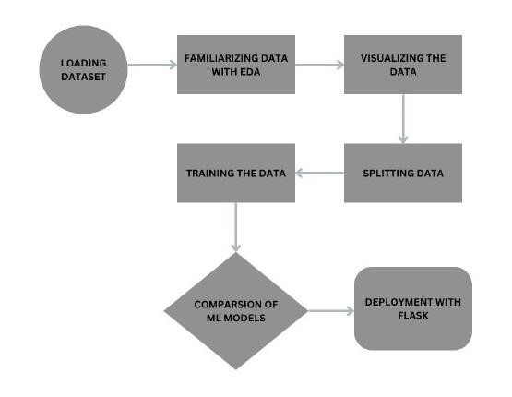
Model Architecture in detail

Slide 10
1. Load data: This involves acquiring the data you want to analyze, which could be from a variety of sources such as databases, text files, or APIs.
2. Familiarize data: This step involves exploring the data to get a basic understanding of its contents. This might include looking at the data types, the distribution of values, and any missing or corrupt data.
3. Visualize the data: Creating visualizations can help you identify patterns and trends in the data that might not be obvious from looking at the raw data.
4. Develop the data: This is where you prepare the data for analysis by cleaning it, transforming it into the format you need, and handling any missing or corrupt data.
5.Train the data: This step involves using the prepared data to train a machine learning model. The model will learn to identify patterns in the data that can be used to make predictions.

Slide 11
6. Split data: This involves dividing the data into two sets: a training set and a testing set. The training set is used to train the model, while the testing set is used to evaluate the model's performance.
7. Comparison of ML models: This step involves comparing the performance of different machine learning models on the testing set. The best performing model will be chosen for deployment.
8. Deployment with Flask: Deploying a Flask application involves several key steps to ensure a smooth and secure experience for users. Begin by preparing the application for production, optimizing dependencies, and configuring files appropriately. Next, choose a deployment method based on preferences and configure the selected hosting solution. Upload the code and dependencies to the chosen platform, and configure databases, environment variables, and security settings.

Slide 12
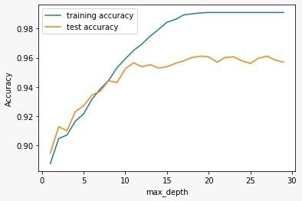
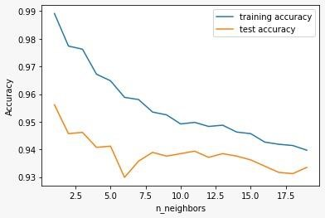
K – Nearest Neighbor
Graphical Results of Different Metrics Considered
Decision Tree

Slide 13
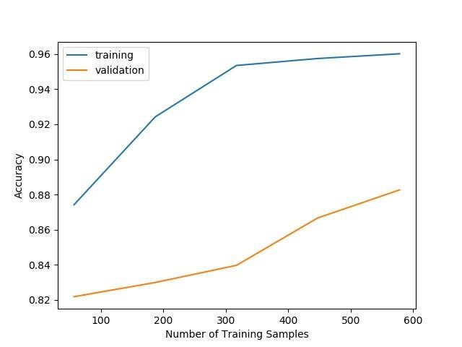
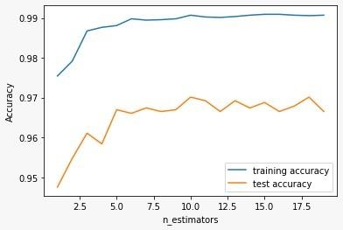
Random Forest Xgboost

Slide 14
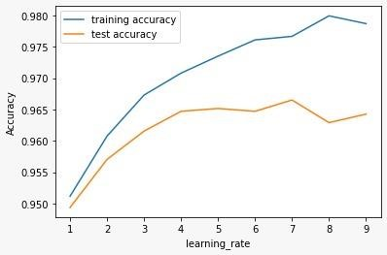
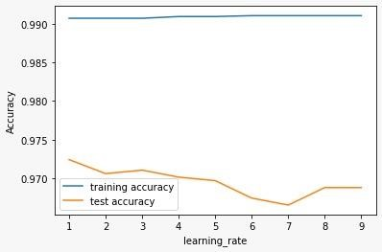
Gradient Boost CatBoost

Slide 15
Comparison of Models
MODELS | ACCURACY | F1_SCORE | RECALL | PRECISION
LOGESTIC REGRESSION | 0.934 | 0.941 | 0.953 | 0.930
K–NEAREST NEIGHBOR | 0.956 | 0.961 | 0.962 | 0.960
SVM | 0.964 | 0.968 | 0.980 | 0.957
NAÏVE BAYES | 0.605 | 0.54 | 0.294 | 0.995
DECISION TREE | 0.961 | 0.965 | 0.964 | 0.966
RANDOM FOREST | 0.967 | 0.970 | 0.972 | 0.966
GRADIENT BOOSTING | 0.974 | 0.977 | 0.989 | 0.966
CATBOOST | 0.911 | 0.975 | 0.982 | 0.969
XGBOOST | 0.969 | 0.973 | 0.993 | 0.984
MULTILAYER PERCEPTRON | 0.954 | 0.980 | 0.967 | 0.923

Slide 16
Interpretation Of Results
The presented machine learning models for phishing website detection showcase diverse performances. Notably, Gradient Boosting stands out with a remarkable accuracy of 97.4%, excelling in precision and recall. It demonstrates the system's capability to effectively identify phishing threats while minimizing false positives and negatives. Other strong performers include XGBoost (96.9% accuracy) and Random Forest (96.7% accuracy), emphasizing their reliability in comprehensive phishing detection.
While Logistic Regression (93.4% accuracy) and K-Nearest Neighbor (95.6% accuracy) exhibit solid performances, Naïve Bayes lags behind with an accuracy of 60.5%, indicating limitations in its suitability for this task. The Multilayer Perceptron, though achieving a respectable accuracy of 95.4%, suggests potential room for improvement in recall.

Slide 17
SVM delivers a robust performance with 96.4% accuracy and a notable recall of 98%, indicating its effectiveness in identifying phishing URLs. CatBoost, with 91.1% accuracy, showcases competitive precision but slightly lower recall.
In summary, the ensemble of models, particularly Gradient Boosting, XGBoost, and Random Forest, presents a powerful arsenal for phishing detection, achieving a balance between accuracy, precision, and recall. The choice of model may depend on specific trade-offs between minimizing false positives and ensuring comprehensive identification of phishing threats.

Slide 18
References
Wenqian Tian; Pei Li; Tao Wei; Zhenkai Liang, 23 August 2017 "Phishing-Alarm: Robust and Efficient Phishing Detection via Page Component Similarity" 17020 – 17030.
B. Deekshitha, Ch. Aswitha, Ch. Shyam Sundar, A. Kavya Deepthi, , June 2022"URL Based Phishing Website Detection by Using Gradient and Catboost Algorithms "IJRASET, Volume 10.
Luka Jovanovic, Dijana Jovanovic, Milos Antonijevic, 18 April 2023" Improving Phishing Website Detection Using a Hybrid Two-level Framework for Feature Selection and XGBoost Tuning", Journal of Web Engineering, Vol. 22 3.
Rishikesh Mahajan, Irffan Siddavatam, October 2018, "Phishing Website Detection using Machine Learning Algorithms ", International Journal of Computer Applications (0975 – 8887) ,Volume 181 – No. 23.

